Slide 1
Cartesian Product-Based Deep Learning Accelerator

Slide 2
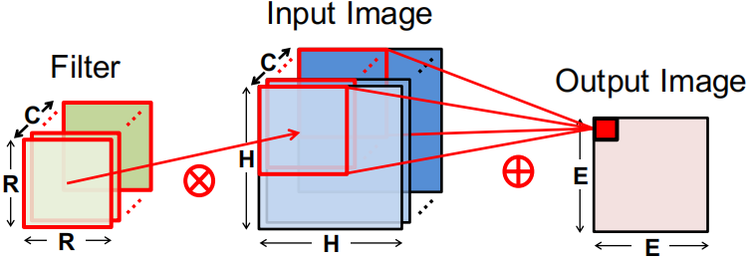
Convolution: One Filter
Input Channel: C

Slide 3
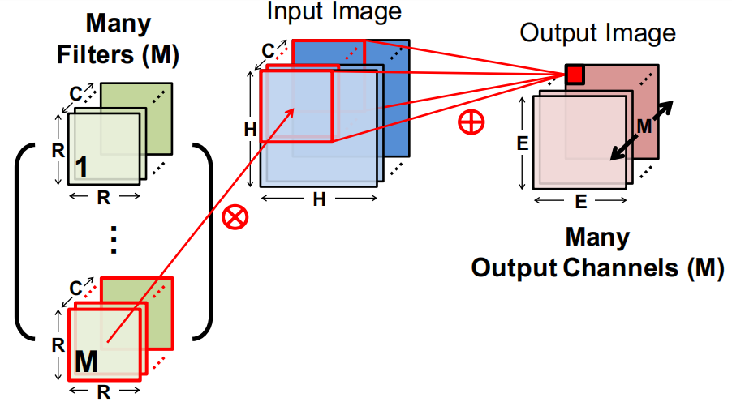
Convolution: Multiple Filters

Slide 4
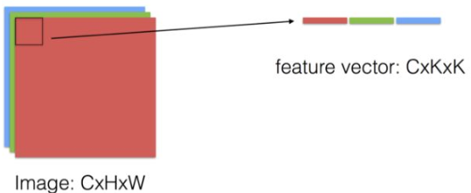
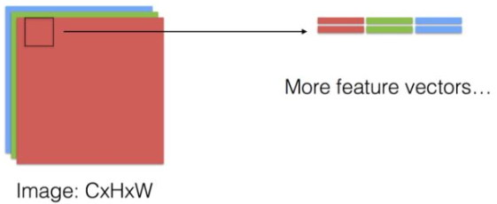
GEMM-Based Convolution
3-D Feature Map -> 2-D Feature Map Matrix

Slide 5
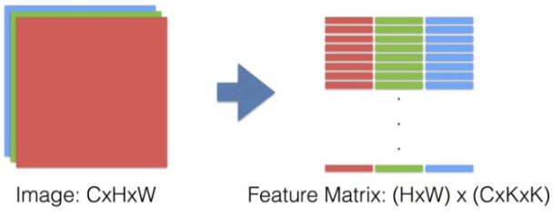
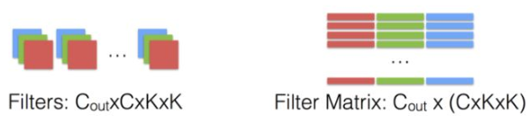
GEMM-Based Convolution
3-D Feature Map -> 2-D Feature Map Matrix
4-D Filter -> 2-D Filter Matrix

Slide 6
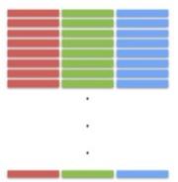

GEMM-Based Convolution
GEMM
Weight
Input Feature Map
Output Feature Map
Hout,Wout: The height/width of output feature map.
(One weight window sliding produces one output feature elements)

Slide 7
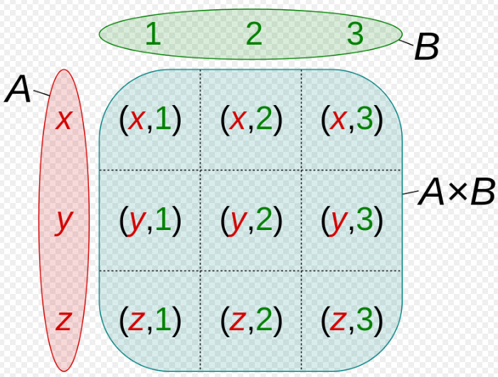
Cartesian Product-Based Matrix Multiplication
Cartesian Product
For sets A and B, the Cartesian product A × B is the set of all ordered pairs (a, b) where a ∈ A and b ∈ B.

Slide 8
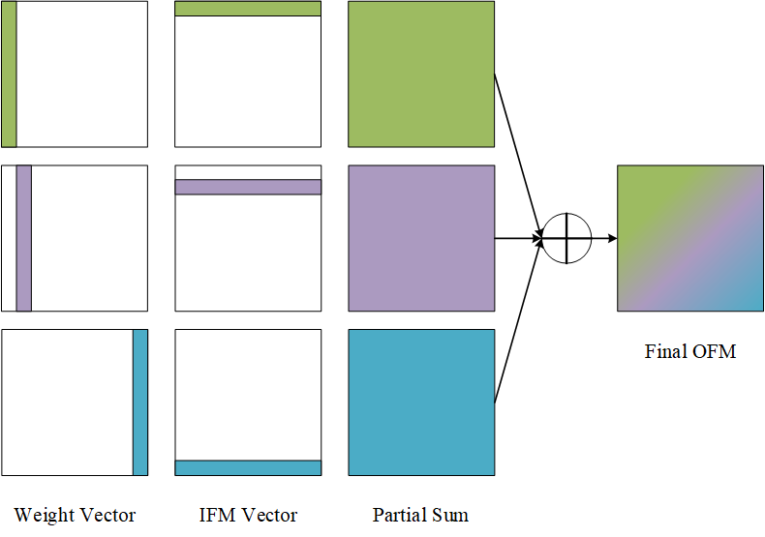
Cartesian Product-Based Matrix Multiplication
Cartesian Product-Based Matrix Multiplication

Slide 9
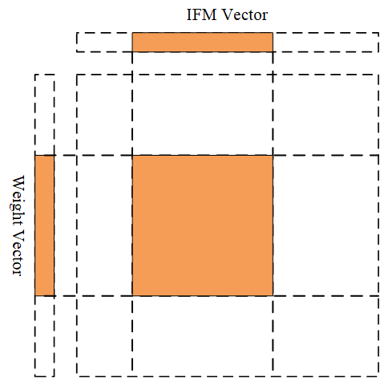
Cartesian Product-Based Matrix Multiplication
Tile Cartesian Product

Slide 10
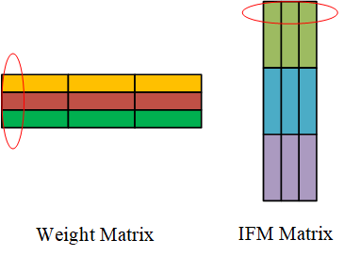
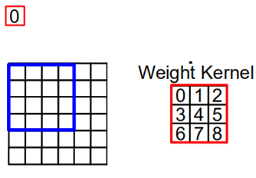
Mapping Cartesian Product to Convolution
Weight Matrix: One color represents one filter. One block represents one input channel / 2-D weight kernel.
IFM Matrix: One color represents one input channel / 2-D input feature map. One column represents one kernel window sliding.
Cartesian Product: One weight is multiplied with all related input feature map elements.
Note: The ISSCC2019 7.1 renames the cartesian product as output feature map moving flow.

Slide 11
Repeated Data in IFM Matrix
2-D IFM Matrix (@stride=1, kernel=3)
1 | 2 | 3 | 4 | 5 | 6 | 7 | 8 | 11 | 12 | 13 | 14 | 15 | 16 | 17 | 18 | 21 | 22 | 23 | 24 | 25 | 26 | 27 | 28
2 | 3 | 4 | 5 | 6 | 7 | 8 | 9 | 12 | 13 | 14 | 15 | 16 | 17 | 18 | 19 | 22 | 23 | 24 | 25 | 26 | 27 | 28 | 29
3 | 4 | 5 | 6 | 7 | 8 | 9 | 10 | 13 | 14 | 15 | 16 | 17 | 18 | 19 | 20 | 23 | 24 | 25 | 26 | 27 | 28 | 29 | 30
11 | 12 | 13 | 14 | 15 | 16 | 17 | 18 | 21 | 22 | 23 | 24 | 25 | 26 | 27 | 28 | 31 | 32 | 33 | 34 | 35 | 36 | 37 | 38
12 | 13 | 14 | 15 | 16 | 17 | 18 | 19 | 22 | 23 | 24 | 25 | 26 | 27 | 28 | 29 | 32 | 33 | 34 | 35 | 36 | 37 | 38 | 39
13 | 14 | 15 | 16 | 17 | 18 | 19 | 20 | 23 | 24 | 25 | 26 | 27 | 28 | 29 | 30 | 33 | 34 | 35 | 36 | 37 | 38 | 39 | 40
21 | 22 | 23 | 24 | 25 | 26 | 27 | 28 | 31 | 32 | 33 | 34 | 35 | 36 | 37 | 38 | 41 | 42 | 43 | 44 | 45 | 46 | 47 | 48
22 | 23 | 24 | 25 | 26 | 27 | 28 | 29 | 32 | 33 | 34 | 35 | 36 | 37 | 38 | 39 | 42 | 43 | 44 | 45 | 46 | 47 | 48 | 49
23 | 24 | 25 | 26 | 27 | 28 | 29 | 30 | 33 | 34 | 35 | 36 | 37 | 38 | 39 | 40 | 43 | 44 | 45 | 46 | 47 | 48 | 49 | 50
1 | 2 | 3 | 4 | 5 | 6 | 7 | 8 | 9 | 10
11 | 12 | 13 | 14 | 15 | 16 | 17 | 18 | 19 | 20
21 | 22 | 23 | 24 | 25 | 26 | 27 | 28 | 29 | 30
31 | 32 | 33 | 34 | 35 | 36 | 37 | 38 | 39 | 40
41 | 42 | 43 | 44 | 45 | 46 | 47 | 48 | 49 | 50
One color represents one kernel window sliding in height dimension. One block represents one input feature map/weight kernel row.
Repeated Data: Block Duplication 1,2,3
Data Shift in one block
Repeated Frequency:1, 2, 3, 4, 6, 9

Slide 12
Repeated Data in IFM Matrix
2-D IFM Matrix (@stride=2, kernel=3)
1 | 3 | 5 | 7 | 9 | 23 | 25 | 27 | 29 | 31 | 45 | 47 | 49 | 51 | 53
2 | 4 | 6 | 8 | 10 | 24 | 26 | 28 | 30 | 32 | 46 | 48 | 50 | 52 | 54
3 | 5 | 7 | 9 | 11 | 25 | 27 | 29 | 31 | 33 | 47 | 49 | 51 | 53 | 55
12 | 14 | 16 | 18 | 20 | 34 | 36 | 38 | 40 | 42 | 56 | 58 | 60 | 62 | 64
13 | 15 | 17 | 19 | 21 | 35 | 37 | 39 | 41 | 43 | 57 | 59 | 61 | 63 | 65
14 | 16 | 18 | 20 | 22 | 36 | 38 | 40 | 42 | 44 | 58 | 60 | 62 | 64 | 66
23 | 25 | 27 | 29 | 31 | 45 | 47 | 49 | 51 | 53 | 67 | 69 | 71 | 73 | 75
24 | 26 | 28 | 30 | 32 | 46 | 48 | 50 | 52 | 54 | 68 | 70 | 72 | 74 | 76
25 | 27 | 29 | 31 | 33 | 47 | 49 | 51 | 53 | 55 | 69 | 71 | 73 | 75 | 77
1 | 2 | 3 | 4 | 5 | 6 | 7 | 8 | 9 | 10 | 11
12 | 13 | 14 | 15 | 16 | 17 | 18 | 19 | 20 | 21 | 22
23 | 24 | 25 | 26 | 27 | 28 | 29 | 30 | 31 | 32 | 33
34 | 35 | 36 | 37 | 38 | 39 | 40 | 41 | 42 | 43 | 44
45 | 46 | 47 | 48 | 49 | 50 | 51 | 52 | 53 | 54 | 55
56 | 57 | 58 | 59 | 60 | 61 | 62 | 63 | 64 | 65 | 66
67 | 68 | 69 | 70 | 71 | 72 | 73 | 74 | 75 | 76 | 77
Repeated Data: Block Duplication 1,2
Data Shift in one block
Repeated Frequency:1, 2, 4

Slide 13
Repeated Data in IFM Matrix
2-D IFM Matrix (@stride=3, kernel=5)
1 | 4 | 7 | 10 | 43 | 46 | 49 | 52 | 85 | 88 | 91 | 94
2 | 5 | 8 | 11 | 44 | 47 | 50 | 53 | 86 | 89 | 92 | 95
3 | 6 | 9 | 12 | 45 | 48 | 51 | 54 | 87 | 90 | 93 | 96
4 | 7 | 10 | 13 | 46 | 49 | 52 | 55 | 88 | 91 | 94 | 97
5 | 8 | 11 | 14 | 47 | 50 | 53 | 56 | 89 | 92 | 95 | 98
15 | 18 | 21 | 24 | 57 | 60 | 63 | 66 | 99 | 102 | 105 | 108
16 | 19 | 22 | 25 | 58 | 61 | 64 | 67 | 100 | 103 | 106 | 109
17 | 20 | 23 | 26 | 59 | 62 | 65 | 68 | 101 | 104 | 107 | 110
18 | 21 | 24 | 27 | 60 | 63 | 66 | 69 | 102 | 105 | 108 | 111
19 | 22 | 25 | 28 | 61 | 64 | 67 | 70 | 103 | 106 | 109 | 112
29 | 32 | 35 | 38 | 71 | 74 | 77 | 80 | 113 | 116 | 119 | 122
30 | 33 | 36 | 39 | 72 | 75 | 78 | 81 | 114 | 117 | 120 | 123
31 | 34 | 37 | 40 | 73 | 76 | 79 | 82 | 115 | 118 | 121 | 124
32 | 35 | 38 | 41 | 74 | 77 | 80 | 83 | 116 | 119 | 122 | 125
33 | 36 | 39 | 42 | 75 | 78 | 81 | 84 | 117 | 120 | 123 | 126
43 | 46 | 49 | 52 | 85 | 88 | 91 | 94 | 127 | 130 | 133 | 136
44 | 47 | 50 | 53 | 86 | 89 | 92 | 95 | 128 | 131 | 134 | 137
45 | 48 | 51 | 54 | 87 | 90 | 93 | 96 | 129 | 132 | 135 | 138
46 | 49 | 52 | 55 | 88 | 91 | 94 | 97 | 130 | 133 | 136 | 139
47 | 50 | 53 | 56 | 89 | 92 | 95 | 98 | 131 | 134 | 137 | 140
57 | 60 | 63 | 66 | 99 | 102 | 105 | 108 | 141 | 144 | 147 | 150
58 | 61 | 64 | 67 | 100 | 103 | 106 | 109 | 142 | 145 | 148 | 151
59 | 62 | 65 | 68 | 101 | 104 | 107 | 110 | 143 | 146 | 149 | 152
60 | 63 | 66 | 69 | 102 | 105 | 108 | 111 | 144 | 147 | 150 | 153
61 | 64 | 67 | 70 | 103 | 106 | 109 | 112 | 145 | 148 | 151 | 154
Repeated Data:
Block Duplication 1,2
Data Shift in one block
Repeated Frequency:1, 2, 4

Slide 14
Repeated Data in IFM Matrix
2-D IFM Matrix (@stride=2, kernel=5)
1 | 3 | 5 | 7 | 9 | 27 | 29 | 31 | 33 | 35 | 53 | 55 | 57 | 59 | 61
2 | 4 | 6 | 8 | 10 | 28 | 30 | 32 | 34 | 36 | 54 | 56 | 58 | 60 | 62
3 | 5 | 7 | 9 | 11 | 29 | 31 | 33 | 35 | 37 | 55 | 57 | 59 | 61 | 63
4 | 6 | 8 | 10 | 12 | 30 | 32 | 34 | 36 | 38 | 56 | 58 | 60 | 62 | 64
5 | 7 | 9 | 11 | 13 | 31 | 33 | 35 | 37 | 39 | 57 | 59 | 61 | 63 | 65
14 | 16 | 18 | 20 | 22 | 40 | 42 | 44 | 46 | 48 | 66 | 68 | 70 | 72 | 74
15 | 17 | 19 | 21 | 23 | 41 | 43 | 45 | 47 | 49 | 67 | 69 | 71 | 73 | 75
16 | 18 | 20 | 22 | 24 | 42 | 44 | 46 | 48 | 50 | 68 | 70 | 72 | 74 | 76
17 | 19 | 21 | 23 | 25 | 43 | 45 | 47 | 49 | 51 | 69 | 71 | 73 | 75 | 77
18 | 20 | 22 | 24 | 26 | 44 | 46 | 48 | 50 | 52 | 70 | 72 | 74 | 76 | 78
27 | 29 | 31 | 33 | 35 | 53 | 55 | 57 | 59 | 61 | 79 | 81 | 83 | 85 | 87
28 | 30 | 32 | 34 | 36 | 54 | 56 | 58 | 60 | 62 | 80 | 82 | 84 | 86 | 88
29 | 31 | 33 | 35 | 37 | 55 | 57 | 59 | 61 | 63 | 81 | 83 | 85 | 87 | 89
30 | 32 | 34 | 36 | 38 | 56 | 58 | 60 | 62 | 64 | 82 | 84 | 86 | 88 | 90
31 | 33 | 35 | 37 | 39 | 57 | 59 | 61 | 63 | 65 | 83 | 85 | 87 | 89 | 91
40 | 42 | 44 | 46 | 48 | 66 | 68 | 70 | 72 | 74 | 92 | 94 | 96 | 98 | 100
41 | 43 | 45 | 47 | 49 | 67 | 69 | 71 | 73 | 75 | 93 | 95 | 97 | 99 | 101
42 | 44 | 46 | 48 | 50 | 68 | 70 | 72 | 74 | 76 | 94 | 96 | 98 | 100 | 102
43 | 45 | 47 | 49 | 51 | 69 | 71 | 73 | 75 | 77 | 95 | 97 | 99 | 101 | 103
44 | 46 | 48 | 50 | 52 | 70 | 72 | 74 | 76 | 78 | 96 | 98 | 100 | 102 | 104
53 | 55 | 57 | 59 | 61 | 79 | 81 | 83 | 85 | 87 | 105 | 107 | 109 | 111 | 113
54 | 56 | 58 | 60 | 62 | 80 | 82 | 84 | 86 | 88 | 106 | 108 | 110 | 112 | 114
55 | 57 | 59 | 61 | 63 | 81 | 83 | 85 | 87 | 89 | 107 | 109 | 111 | 113 | 115
56 | 58 | 60 | 62 | 64 | 82 | 84 | 86 | 88 | 90 | 108 | 110 | 112 | 114 | 116
57 | 59 | 61 | 63 | 65 | 83 | 85 | 87 | 89 | 91 | 109 | 111 | 113 | 115 | 117
Repeated Data:
Block Duplication 1,2,3
Data Shift in one block
Repeated Frequency:1, 2, 3, 4, 6, 9

Slide 15
Repeated Data in IFM Matrix
Summary
 | Number #
Block Height | K
Block Width | Wout
Block | K x Hout x Cin
Block Duplication | celi(K / S)
Data Repeat in One Block | celi(K / S)
Shift Sequence | S
S: Stride
K: Kernel size
Cin: The number of input channel
Wout: The width of output feature map
Hout: The height of output feature map

Slide 16
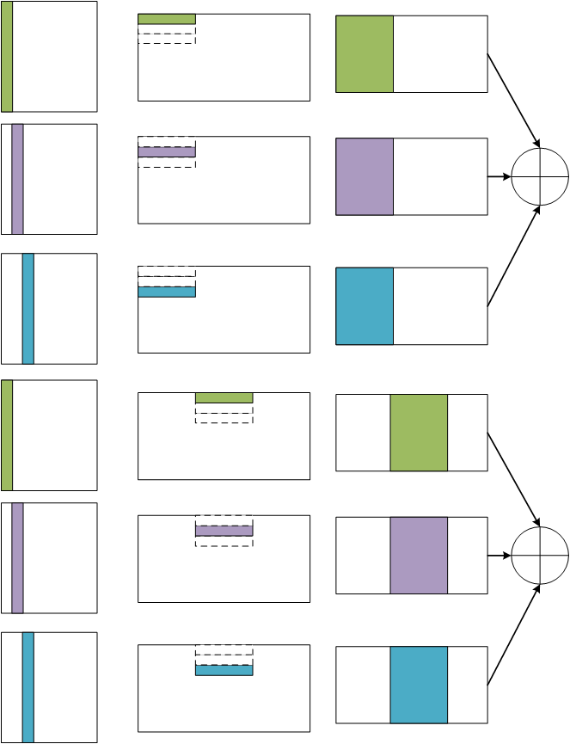
Hardware-Limited Cartesian-Product CNN
Input Feature Map Tile Fix
Weight Repeat Load

Slide 17
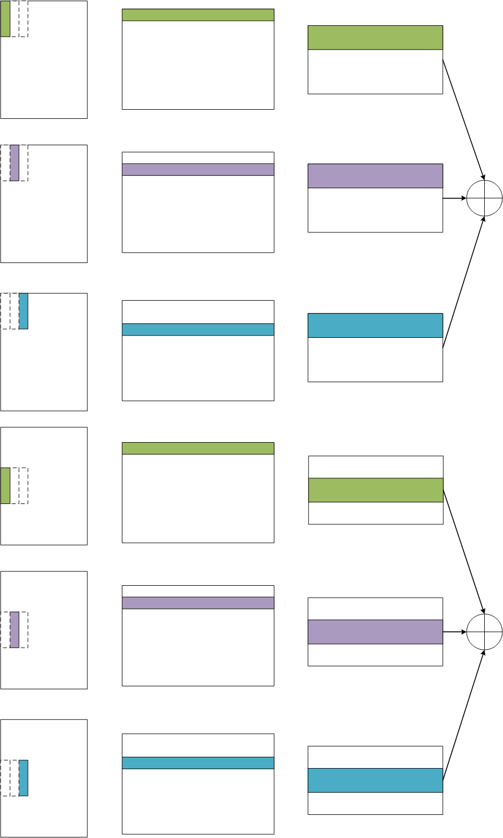
Hardware-Limited Cartesian-Product CNN
Weight Tile Fix
IFM Repeat Load!!!
Note: We will fully use the input. Choose
IFM Fix

Slide 18
Computation Flow in one PE
@Stride=1 Kernel=3
1 | 2 | 3 | 4
2 | 3 | 4 | 5
3 | 4 | 5 | 6
One number represents one block.
The block is processed temporally one by one.
The “output memory” is occupied by two different output tile in turn.
@Stride=2 Kernel=3
@Stride=3 Kernel=5
1 | 3 | 5 | 7
2 | 4 | 6 | 8
3 | 5 | 7 | 9
1 | 4 | 7 | 10
2 | 5 | 8 | 11
3 | 6 | 9 | 12
4 | 7 | 10 | 13
5 | 8 | 11 | 14

Slide 19
Computation Flow in one PE
@Stride=2 Kernel=5
1 | 3 | 5 | 7
2 | 4 | 6 | 8
3 | 5 | 7 | 9
4 | 6 | 8 | 10
5 | 7 | 9 | 11
Computation Parallel: Different PE processes blocks in different input channel.

Slide 20
A Naive PE Model
PE Model
The weight and input are both broadcast to MAC arrcy.
The zero weight/IFM can be easily gatted.

Slide 21
Future Work
Future Work
Flexible MAC array reorganization: if the output channel is less than the size of weight vector buffer, the weight broadcast method induces low MAC utilization. (Possible Solution: Divide the PE into multi sub-PE.)
Zero Skipping: especially zero weight skipping.
Feature Map Forwarding: without repeated calculation.

